Slide 1
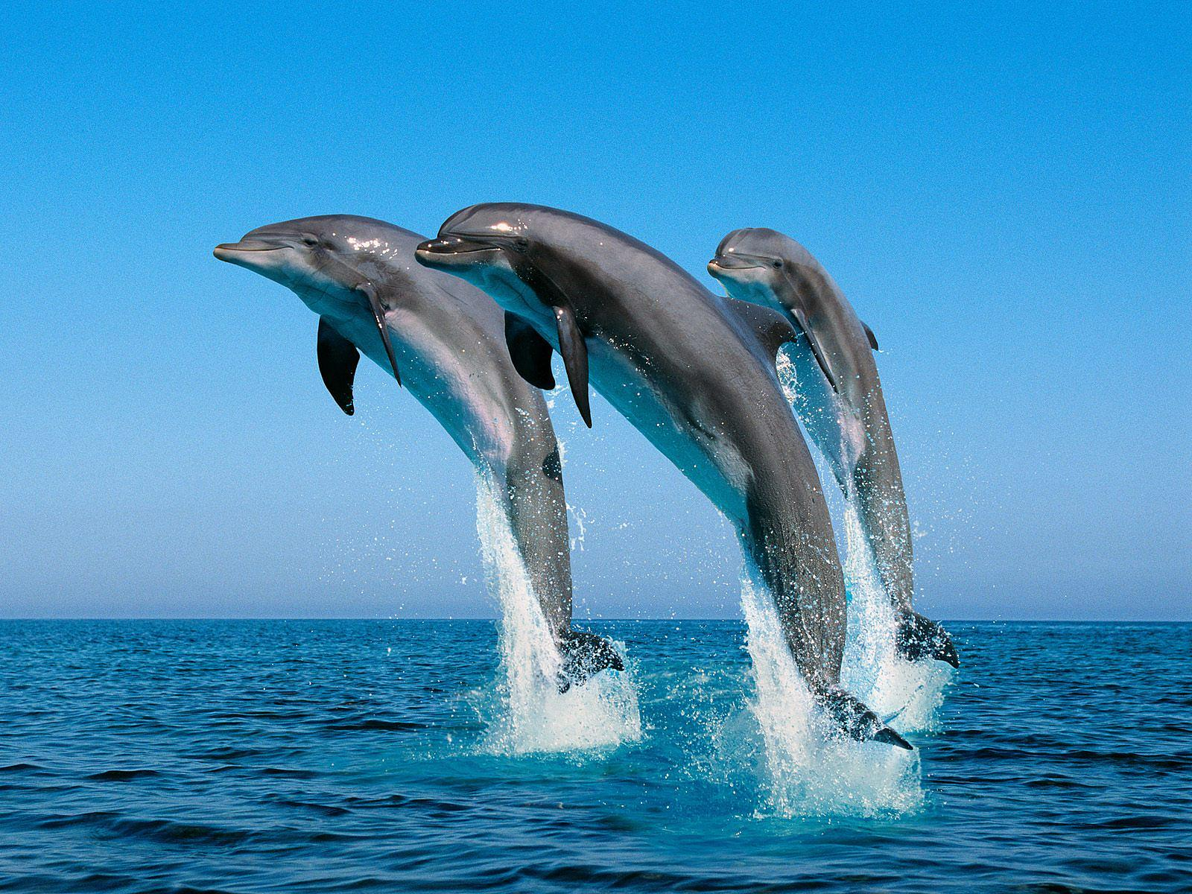
Back to School Night 2023-2024
Welcome!
Mrs. Alonso
^{6th Grade}
This Photo by Unknown Author is licensed under CC BY-SA

Slide 2
Student Expectations
Students are expected to follow PAWS
Rewards:
Class Marble Jar
Class tickets
Students earn 1 ticket each day that they don’t earn a consequence
Reward Store (bi-weekly)
Trimester Auction
Consequences:
1st Offense: Redirect
2nd Offense: Sideline
3rd Offense: Reflect
4th Offense: Letter Home
All major offenses will result in an office referral..
A copy of the letter with our classroom management program has been provided.

Slide 3
If your child is absent…
When your child returns:
Missing assignments will be organized on their desk.
They will have as many days as they were absent to complete the work.
Requesting Work:
Contact the office to request your child’s materials and any absent work.
Absent work will be brought up to the office by 3:00 and must be picked up by 4:00.
Extracurricular Activities:
Students who miss class due to participation in extracurricular activities (band, Christian Release, Student Council, etc.) are accountable for all missed work.

Slide 4
Projects
Homework
Students are expected to write HW in their agendas daily.
Nightly HW:
Reading – 30 minutes
Up to 10 Math problems to help reinforce concepts taught. Math Notes should be going home nightly.
No HW given on Fridays
Homework is due at the start of class
Missing/late HW and Classwork affects your child’s Homework grade on the report card.
There will be projects due throughout the year.
Students and parents will be notified in advance of due dates.
All necessary requirements will be given.

Slide 5
Grading Policy
Tests/Assignments:
Performance Levels based on a 1-4 rubric
Level 1: 49% or below (Beginning)
Not meeting grade level standards
Level 2 : 50% - 69% (Progressing)
Partially meeting grade level standards
Level 3: 70% - 89% (Achieving)
Consistently meeting grade level standards
Level 4: 90% - 100% (Extending)
In-depth understanding
Homework and Classwork Grading Policy
4 = 0-2 missing assignments
3 = 3-5 missing assignments
2 = 6-8 missing assignments
1 = 9 or more missing assignments

Slide 6
How will I communicate with you?
Weekly Folders
*Graded work
Email
*Specific behavior/academic concerns
Phone Call Home
*Specific behavior/academic concerns
Letter Home (per our management program)
*Fourth offense
ClassDojo
*Class Announcements

Slide 7
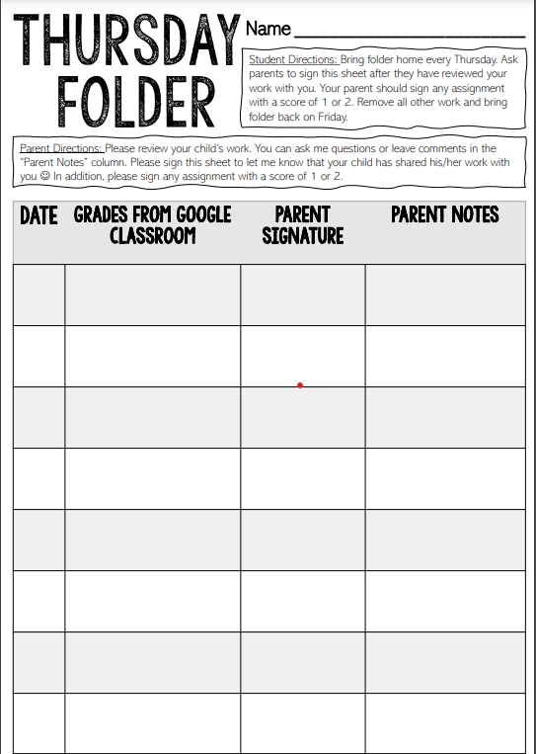
Weekly Folders
Red Folders:
Will go home every THURSDAY.
Please review graded work and sign any test/quiz with 2 or below and return it in the folder.
Your child will hand-write any “digital” grades from Google Classroom, Big Ideas Math, or McGraw Hill ConnectEd.
Please sign the Thursday sheet to indicate you have reviewed their graded work.
Send folder back to school with your child on Friday.

Slide 8
Communication
PAW Print and Oak Ridge Website
Refer to the PAW Print (sent weekly through AERIES) and the Oak Ridge homepage for school/PTA announcements and upcoming events
ClassDojo
Class Announcements are posted in “Class Story”
Comments left on “Story” are public
Private Messaging: General Questions only
Email
Specific questions, concerns, and comments
Selina_Alonso@chino.k12.ca.us
I am committed to answering Dojo messages and Email within 24 hours on weekdays

Slide 9
Technology
One-to-One Devices in the classroom
Chromebooks are checked out to students and will go home as needed.
Some assignments will be completed in Google Classroom, Big Ideas, or McGraw Hill ConnectEd
Students access apps through ClassLink on Oak Ridge Homepage.

Slide 10
English Language Arts (ELA)
Reading: Literature
Reading: Informational Text
Speaking and Listening
Language
Conventions
(Grammar)
Wonders
Novel Studies
Integration of text
(compare/contrast)
Key Ideas and Details
Craft and Structure
(meaning of text)
Vocabulary Acquisition and Use

Slide 11
Math
The Number System
Expressions and Equations
Ratios and Proportional Relationships
Statistics
And
Probability
Geometry
*Must Know Multiplication Facts
Materials
Textbook
Record and Practice Journal
2 Notebooks
Whiteboard and marker
Some Assignments may be given in Big Ideas Math Online.
*Students can access the textbook online

Slide 12
Writing
Informative/Explanatory
Write texts to examine a topic and convey ideas and information.
Argumentative
Write arguments to support claims with evidence to support.
Narrative
Write real or imagined experiences.

Slide 13
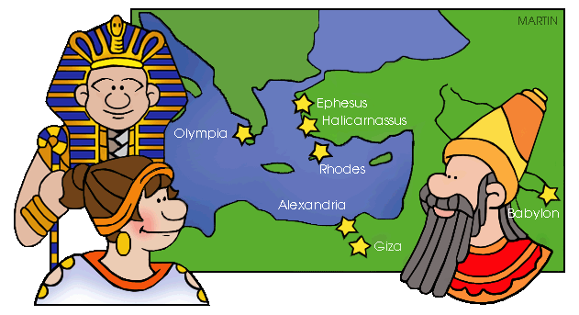
Social Studies
Science
Ancient Civilizations
Mesopotamia
Egypt
Greece
Rome
India
China
Discovery Education
Systems on Earth
Causes of Weather
Causes and Effects of Regional Climate
*

Slide 14
Parent – Teacher Conferences
Parent Conferences can be held in person or virtually through ZOOM.
*Held the week of September 25th
Each conference will be about 15 minutes.
Information with a Sign-Up Genius will be sent through ClassDojo the week of September 11.
This Photo by Unknown Author is licensed under CC BY-SA-NC

Slide 15
Volunteers:
4 Class Parties = Harvest, Winter, Valentine’s, End of the Year
Art Prep
Knott’s Berry Farm = 6th
Promotion
Field Day
*Sign ups on the back counter for
Art Prep and Classroom Volunteers.

Slide 16
Teacher Wish List:
Disinfectant Wipes
Tissue boxes
Sticky notes
Expo markers
Glue sticks
Scissors
Markers
Colored pencils
Graph paper
College ruled paper/college ruled notebooks
This Photo by Unknown Author is licensed under CC BY-NC

